Slide 2
BCI’s Mission
Our mission is to inspire and support people with disabilities, challenging personal growth and development through a continuum of innovative employment opportunities.

Slide 3
About Us
The BCI Skills Center provides vocational training and competitive employment services for individuals with disabilities.
Upon graduation from the BCI Skills Center, students move directly into the competitive workforce where they work alongside non-disabled individuals, earning the same opportunities, responsibilities, benefits, and pay.
We partner with companies in the region to create customized training that prepares students for specific jobs.
We recruit students and train them for 8 weeks. Employment partners hire them and we provide up to 6 hours of follow-along support each month.
We currently offer training programs in Manufacturing, Hospitality, Warehouse, and Health Care & Social Assistance.
We are also working on launching an Information Technology program.

Slide 4
Training Program Employment Partners

Slide 5
BCI’s Skills Center Results To Date
Graduates:
54 since 2019 with an average starting wage of $16.50 an hour, and some earning as much as $24
Nearly all work a full-time schedule and receive customized pay and benefits counseling from BCI
Success
An overall job placement rate of 94.7% and an 85.7% job retention rate after six months.
Partnerships
8 companies have joined with us to train and hire graduates. Almost all tuition is fully covered by funders (SB40 boards & Vocational Rehab).
Independence
Multiple graduates have moved into their own homes as a result of the resources they have earned.

Slide 6
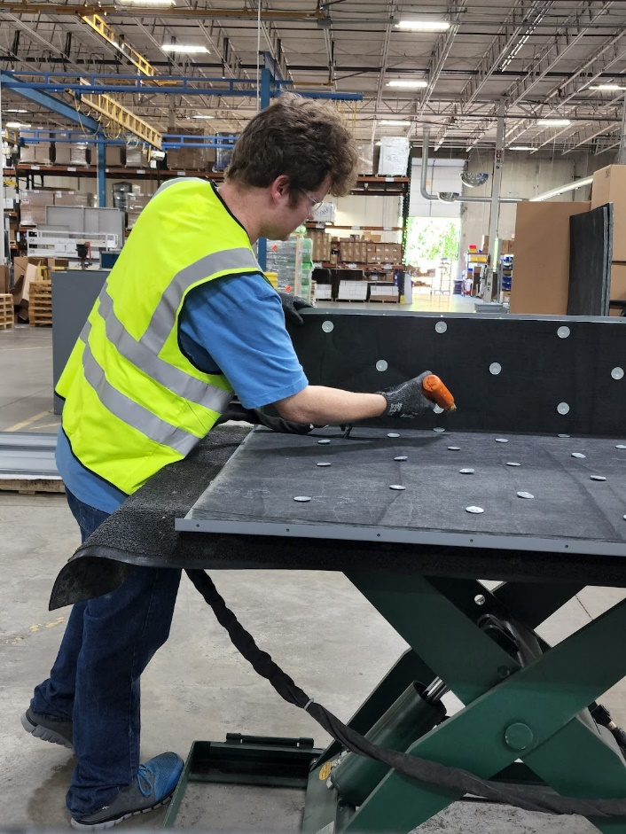
Why does an Organization Partner with the BCI Skills Center?
They need talent! We recruit and screen all students and provide a vocational instructor for each training class.
Our course work is accredited by Missouri Department of Higher Education
In most cases, training is done on-site at the employment partner’s business.
Our students want to work and tend to be loyal employees.
Our students are well prepared and gain necessary skills applicable to their jobs.
We provide job retention support services for all of our graduates.
We can provide disability training to employment partners.

Slide 7
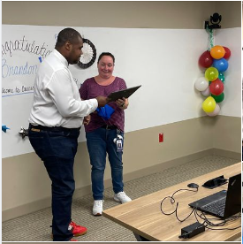
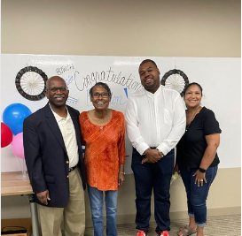
Celebrating Brandon & BJC Healthcare
Brandon graduated from our Skills Center’s inaugural class and began working as a housekeeper at BJC West County Hospital in Creve Coeur!
Brandon was a superstar I training. He arrived 30 minutes early for class – his positive, outgoing spirit uplifted everyone around him.
Brandon pave the way for us to bring these talented students and the BCI training program to the to the regions largest employer, BJC Healthcare
BJC is working with us to expand the program to St. Louis Children’s Hospital, Christian Hospital, and Missouri Baptist Medical Center

Slide 8
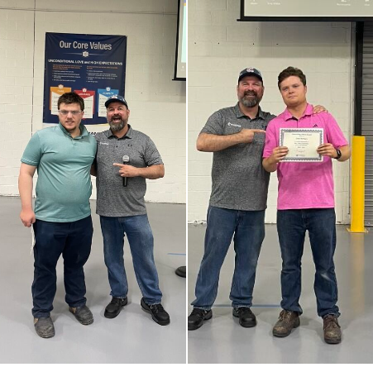
Celebrating Joe and Shane!
Joe and Shane were our first graduates from our Cambridge Air Solutions manufacturing program and first graduates in St. Louis County.
In August, they celebrated their one year anniversary.
From Cambridge, “We are incredibly grateful to be celebrating Joe and Shane for their one-year anniversary with our team. Since they joined us through Skills Center STL, they have proven to be absolutely outstanding. Their dedication, skills, and contributions have made them an integral and invaluable part of our team. We appreciate their hard work and commitment, and we look forward to many more successful years together. Thank you, Joe and Shane, for being awesome!”

Slide 9
What’s next for BCI Skills Center?
We have ambitious goals to reach more individuals and graduate over 40 individuals from skills training programs in fiscal year 2024 and place another 80 through competitive employment. Many of those training programs will be with new employer partners in St. Louis County and beyond.

Slide 10
Contact Us
Jeremy Sutton
Chief Program Officer – Skills Center
jsutton@boonecenter.com
(636) 875-5252

